Slide 1



CNN Architectures
Indian Institute of Information Technology, Allahabad
By
Dr. Shiv Ram Dubey Assistant Professor Computer Vision And Biometrics Lab (CVBL) Department Of Information Technology Indian Institute Of Information Technology, Allahabad
Email: srdubey@iiita.ac.in Web: https://profile.iiita.ac.in/srdubey/

Slide 2
Disclaimer
The content (text, image, and graphics) used in this slide are adopted from many sources for academic purposes. Broadly, the sources have been given due credit appropriately. However, there is a chance of missing out some original primary sources. The authors of this material do not claim any copyright of such material.

Slide 3
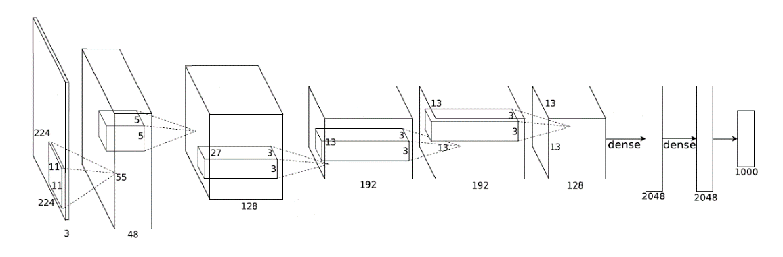
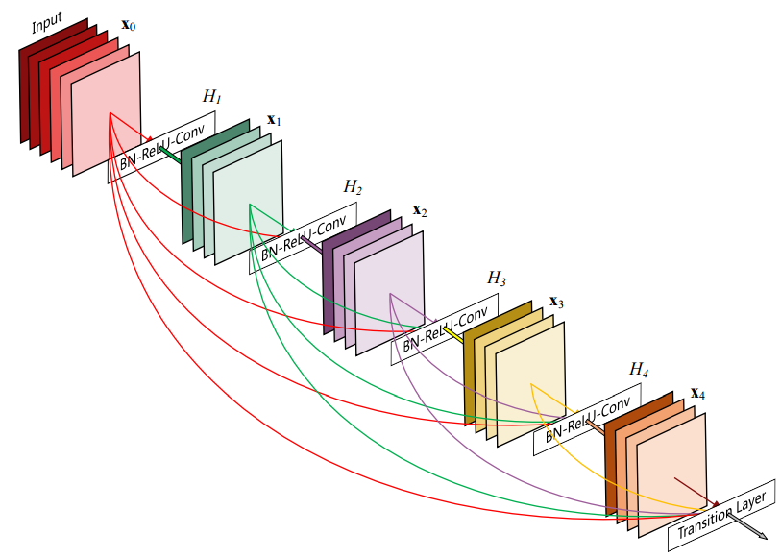
CNN Architectures for classification
CNN Architectures: Plain Models
LeNet
AlexNet
ZFNet
VggNet
Network in Network
CNN Architectures: DAG Models
GoogLeNet
ResNet
Pre-act ResNet
SENet
DenseNet
ResNetXt
Etc.

Slide 4
CNN Architectures: Plain Models
LeNet
AlexNet
ZFNet
VggNet
Network in Network

Slide 5
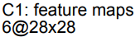
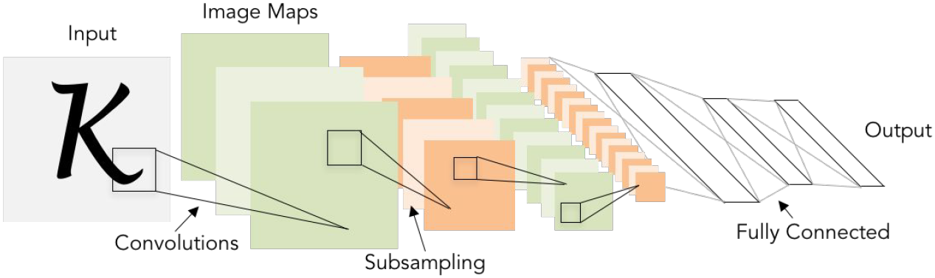
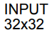
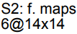
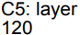
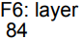
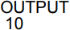
Review: LeNet-5
LeCun et al. Gradient-based learning applied to document recognition.
Proceedings of the IEEE, 1998.
Source: cs231n

Slide 6
Review: LeNet-5
Conv filters are 5x5, applied at stride 1
Subsampling (Pooling) layers are 2x2 applied at stride 2
i.e. architecture is [CONV-POOL-CONV-POOL-CONV-FC-FC]
LeCun et al. Gradient-based learning applied to document recognition.
Proceedings of the IEEE, 1998.
Source: cs231n

Slide 7
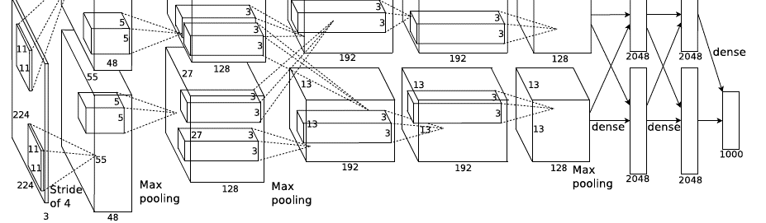
AlexNet
Architecture:
CONV1 MAX POOL1 NORM1(Local Response Normalization)
CONV2 MAX POOL2 NORM2(Local Response Normalization)
CONV3
CONV4
CONV5 Max POOL3
FC6
FC7
FC8
Krizhevsky, et al. Imagenet classification with deep convolutional neural networks. NIPS 2012.
Source: cs231n

Slide 8
AlexNet
Input: 227x227x3 images
First layer (CONV1): 96 11x11 filters applied at stride 4
=>
Q: what is the output volume size? Hint: (227-11)/4+1 = 55
Krizhevsky, et al. Imagenet classification with deep convolutional neural networks. NIPS 2012.
Source: cs231n

Slide 9
AlexNet
Input: 227x227x3 images
First layer (CONV1): 96 11x11 filters applied at stride 4
=>
Output volume [55x55x96]
Q: What is the total number of parameters in this layer?
Krizhevsky, et al. Imagenet classification with deep convolutional neural networks. NIPS 2012.
Source: cs231n

Slide 10
AlexNet
Input: 227x227x3 images
First layer (CONV1): 96 11x11 filters applied at stride 4
=>
Output volume [55x55x96]
Parameters: (11*11*3)*96 = 35K
Krizhevsky, et al. Imagenet classification with deep convolutional neural networks. NIPS 2012.
Source: cs231n

Slide 11
AlexNet
Input: 227x227x3 images
After CONV1: 55x55x96
Second layer (POOL1): 3x3 filters applied at stride 2
Q: what is the output volume size? Hint: (55-3)/2+1 = 27
Krizhevsky, et al. Imagenet classification with deep convolutional neural networks. NIPS 2012.
Source: cs231n

Slide 12
AlexNet
Input: 227x227x3 images
After CONV1: 55x55x96
Second layer (POOL1): 3x3 filters applied at stride 2
Output volume [27x27x96]
Q: what is the number of parameters in this layer?
Krizhevsky, et al. Imagenet classification with deep convolutional neural networks. NIPS 2012.
Source: cs231n

Slide 13
AlexNet
Input: 227x227x3 images
After CONV1: 55x55x96
Second layer (POOL1): 3x3 filters applied at stride 2
Output volume [27x27x96]
Parameters: 0!
Krizhevsky, et al. Imagenet classification with deep convolutional neural networks. NIPS 2012.
Source: cs231n

Slide 14
AlexNet
Input: 227x227x3 images
After CONV1: 55x55x96
After POOL1: 27x27x96
...
Krizhevsky, et al. Imagenet classification with deep convolutional neural networks. NIPS 2012.
Source: cs231n

Slide 15
AlexNet
Full (simplified) AlexNet architecture:
[227x227x3] INPUT
[55x55x96] CONV1: 96 11x11 filters at stride 4, pad 0
[27x27x96] MAX POOL1: 3x3 filters at stride 2
[27x27x96] NORM1: Normalization layer
[27x27x256] CONV2: 256 5x5 filters at stride 1, pad 2
[13x13x256] MAX POOL2: 3x3 filters at stride 2
[13x13x256] NORM2: Normalization layer
[13x13x384] CONV3: 384 3x3 filters at stride 1, pad 1
[13x13x384] CONV4: 384 3x3 filters at stride 1, pad 1
[13x13x256] CONV5: 256 3x3 filters at stride 1, pad 1
[6x6x256] MAX POOL3: 3x3 filters at stride 2
[4096] FC6: 4096 neurons
[4096] FC7: 4096 neurons
[1000] FC8: 1000 neurons (class scores)
Krizhevsky, et al. Imagenet classification with deep convolutional neural networks. NIPS 2012.
Source: cs231n

Slide 16
AlexNet
[55x55x48] x 2
Full (simplified) AlexNet architecture:
[227x227x3] INPUT
[55x55x96] CONV1: 96 11x11 filters at stride 4, pad 0
[27x27x96] MAX POOL1: 3x3 filters at stride 2
[27x27x96] NORM1: Normalization layer
[27x27x256] CONV2: 256 5x5 filters at stride 1, pad 2
[13x13x256] MAX POOL2: 3x3 filters at stride 2
[13x13x256] NORM2: Normalization layer
[13x13x384] CONV3: 384 3x3 filters at stride 1, pad 1
[13x13x384] CONV4: 384 3x3 filters at stride 1, pad 1
[13x13x256] CONV5: 256 3x3 filters at stride 1, pad 1
[6x6x256] MAX POOL3: 3x3 filters at stride 2
[4096] FC6: 4096 neurons
[4096] FC7: 4096 neurons
[1000] FC8: 1000 neurons (class scores)
Historical note: Trained on GTX 580 GPU with only 3 GB of memory. Network spread across 2 GPUs, half the neurons (feature maps) on each GPU.
Krizhevsky, et al. Imagenet classification with deep convolutional neural networks. NIPS 2012.
Source: cs231n

Slide 17
AlexNet
Full (simplified) AlexNet architecture:
[227x227x3] INPUT
[55x55x96] CONV1: 96 11x11 filters at stride 4, pad 0
[27x27x96] MAX POOL1: 3x3 filters at stride 2
[27x27x96] NORM1: Normalization layer
[27x27x256] CONV2: 256 5x5 filters at stride 1, pad 2
[13x13x256] MAX POOL2: 3x3 filters at stride 2
[13x13x256] NORM2: Normalization layer
[13x13x384] CONV3: 384 3x3 filters at stride 1, pad 1
[13x13x384] CONV4: 384 3x3 filters at stride 1, pad 1
[13x13x256] CONV5: 256 3x3 filters at stride 1, pad 1
[6x6x256] MAX POOL3: 3x3 filters at stride 2
[4096] FC6: 4096 neurons
[4096] FC7: 4096 neurons
[1000] FC8: 1000 neurons (class scores)
CONV1, CONV2, CONV4, CONV5: Connections only with feature maps on same GPU
Krizhevsky, et al. Imagenet classification with deep convolutional neural networks. NIPS 2012.
Source: cs231n

Slide 18
AlexNet
Full (simplified) AlexNet architecture:
[227x227x3] INPUT
[55x55x96] CONV1: 96 11x11 filters at stride 4, pad 0
[27x27x96] MAX POOL1: 3x3 filters at stride 2
[27x27x96] NORM1: Normalization layer
[27x27x256] CONV2: 256 5x5 filters at stride 1, pad 2
[13x13x256] MAX POOL2: 3x3 filters at stride 2
[13x13x256] NORM2: Normalization layer
[13x13x384] CONV3: 384 3x3 filters at stride 1, pad 1
[13x13x384] CONV4: 384 3x3 filters at stride 1, pad 1
[13x13x256] CONV5: 256 3x3 filters at stride 1, pad 1
[6x6x256] MAX POOL3: 3x3 filters at stride 2
[4096] FC6: 4096 neurons
[4096] FC7: 4096 neurons
[1000] FC8: 1000 neurons (class scores)
CONV3, FC6, FC7, FC8:
Connections with all feature maps in preceding layer, communication across GPUs
Krizhevsky, et al. Imagenet classification with deep convolutional neural networks. NIPS 2012.
Source: cs231n

Slide 19
AlexNet
Full (simplified) AlexNet architecture:
[227x227x3] INPUT
[55x55x96] CONV1: 96 11x11 filters at stride 4, pad 0
[27x27x96] MAX POOL1: 3x3 filters at stride 2
[27x27x96] NORM1: Normalization layer
[27x27x256] CONV2: 256 5x5 filters at stride 1, pad 2
[13x13x256] MAX POOL2: 3x3 filters at stride 2
[13x13x256] NORM2: Normalization layer
[13x13x384] CONV3: 384 3x3 filters at stride 1, pad 1
[13x13x384] CONV4: 384 3x3 filters at stride 1, pad 1
[13x13x256] CONV5: 256 3x3 filters at stride 1, pad 1
[6x6x256] MAX POOL3: 3x3 filters at stride 2
[4096] FC6: 4096 neurons
[4096] FC7: 4096 neurons
[1000] FC8: 1000 neurons (class scores)
Details/Retrospectives:
- first use of ReLU
- used Norm layers (not common anymore)
- heavy data augmentation
- batch size 128
- SGD Momentum 0.9
- Learning rate 0.01, reduced manually when val accuracy saturates
Krizhevsky, et al. Imagenet classification with deep convolutional neural networks. NIPS 2012.
Source: cs231n

Slide 20
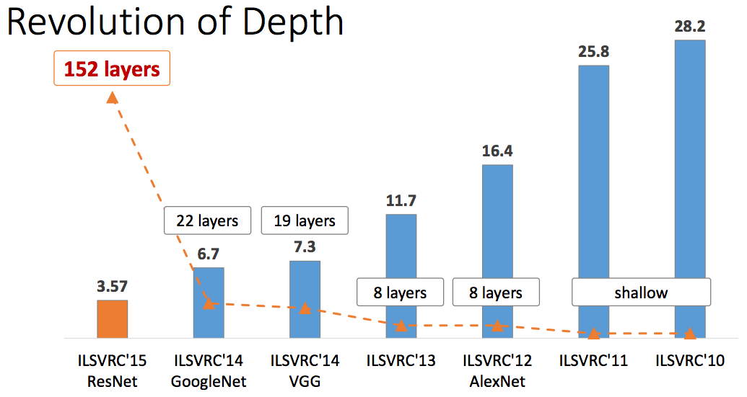
ImageNet Large Scale Visual Recognition Challenge (ILSVRC) winners
First CNN based Winner
K. He, X. Zhang, S. Ren, J. Sun, Deep Residual Learning for Image Recognition, IEEE CVPR 2016.

Slide 21
ImageNet Large Scale Visual Recognition Challenge (ILSVRC) winners
ZFNet: Improved
hyperparameters over
AlexNet
K. He, X. Zhang, S. Ren, J. Sun, Deep Residual Learning for Image Recognition, IEEE CVPR 2016.

Slide 22
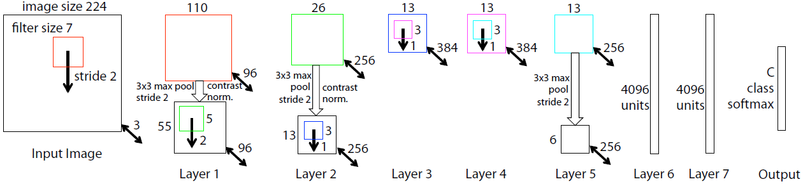
ZFNet
AlexNet but:
CONV1: change from (11x11 stride 4) to (7x7 stride 2)
CONV3,4,5: instead of 384, 384, 256 filters use 512, 1024, 512
ImageNet top 5 error: 16.4% -> 11.7%
M. Zeiler, R. Fergus. Visualizing and understanding convolutional networks. ECCV 2014.
Source: cs231n

Slide 23
ImageNet Large Scale Visual Recognition Challenge (ILSVRC) winners
Deeper Networks
K. He, X. Zhang, S. Ren, J. Sun, Deep Residual Learning for Image Recognition, IEEE CVPR 2016.

Slide 24

VGGNet
VGG16 (source)
Simonyan et al. Very deep convolutional networks for large-scale image recognition. ICLR2015.

Slide 25
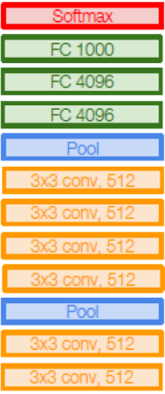
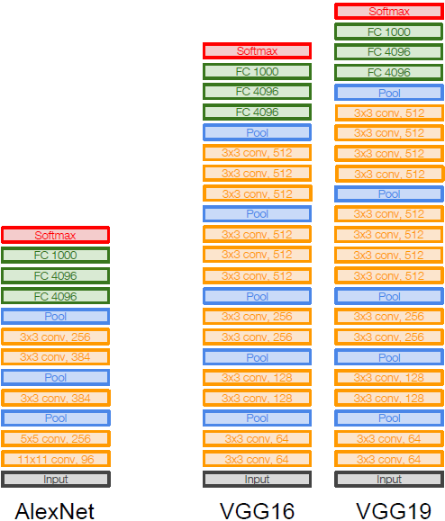
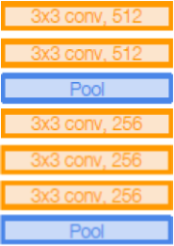
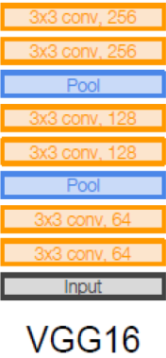
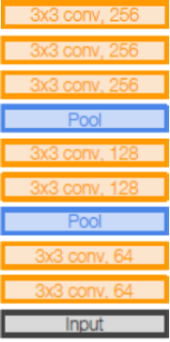
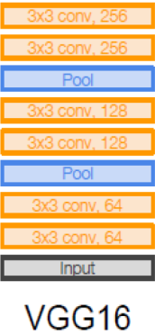
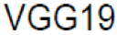
VGGNet
Small filters, Deeper networks
8 layers (AlexNet)
-> 16 - 19 layers (VGGNet)
Only 3x3 CONV stride 1, pad 1
and 2x2 MAX POOL stride 2
Simonyan et al. Very deep convolutional networks for large-scale image recognition. ICLR2015.
Source: cs231n

Slide 26
VGGNet
Small filters, Deeper networks
8 layers (AlexNet)
-> 16 - 19 layers (VGGNet)
Only 3x3 CONV stride 1, pad 1
and 2x2 MAX POOL stride 2
ImageNet top 5 error:
11.4% (ZFNet, 2013)
->
7.3% (VGGNet, 2014)
Simonyan et al. Very deep convolutional networks for large-scale image recognition. ICLR2015.
Source: cs231n

Slide 27
VGGNet
Q: Why use smaller filters? (3x3 conv)
Simonyan et al. Very deep convolutional networks for large-scale image recognition. ICLR2015.
Source: cs231n

Slide 28
VGGNet
Q: Why use smaller filters? (3x3 conv)
Stack of three 3x3 conv (stride 1) layers
has same effective receptive field as
one 7x7 conv layer
Simonyan et al. Very deep convolutional networks for large-scale image recognition. ICLR2015.
Source: cs231n

Slide 29
VGGNet
Q: Why use smaller filters? (3x3 conv)
Stack of three 3x3 conv (stride 1) layers
has same effective receptive field as
one 7x7 conv layer
Q: What is the effective receptive field of
three 3x3 conv (stride 1) layers?
Simonyan et al. Very deep convolutional networks for large-scale image recognition. ICLR2015.
Source: cs231n

Slide 30
VGGNet
Q: Why use smaller filters? (3x3 conv)
Stack of three 3x3 conv (stride 1) layers
has same effective receptive field as
one 7x7 conv layer
Q: What is the effective receptive field of
three 3x3 conv (stride 1) layers?
[7x7]
But deeper, more non-linearities
And fewer parameters: 3 * (3²C²) vs.
7²C² for C channels per layer
Simonyan et al. Very deep convolutional networks for large-scale image recognition. ICLR2015.
Source: cs231n

Slide 31
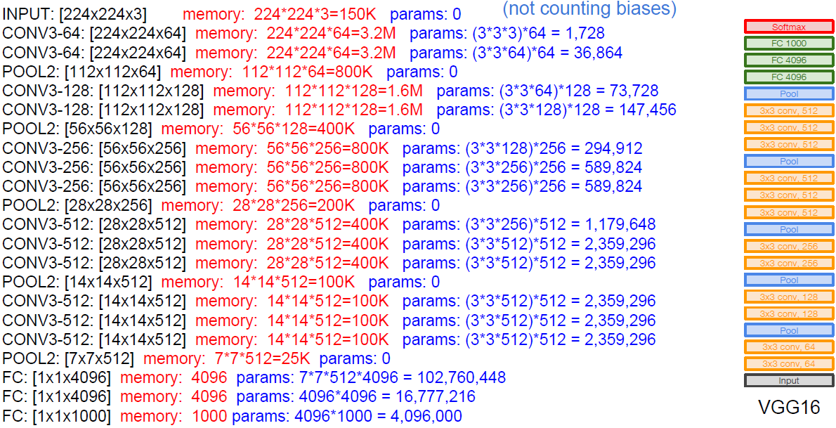
VGGNet
Simonyan et al. Very deep convolutional networks for large-scale image recognition. ICLR2015.
Source: cs231n

Slide 32
VGGNet
TOTAL memory: 24M * 4 bytes ~= 96MB / image (only forward! ~*2 for bwd)
TOTAL params: 138M parameters
Simonyan et al. Very deep convolutional networks for large-scale image recognition. ICLR2015.
Source: cs231n

Slide 33
VGGNet
Note:
Most memory is in early CONV
Most params are in late FC
TOTAL memory: 24M * 4 bytes ~= 96MB / image (only forward! ~*2 for bwd)
TOTAL params: 138M parameters
Simonyan et al. Very deep convolutional networks for large-scale image recognition. ICLR2015.
Source: cs231n

Slide 34
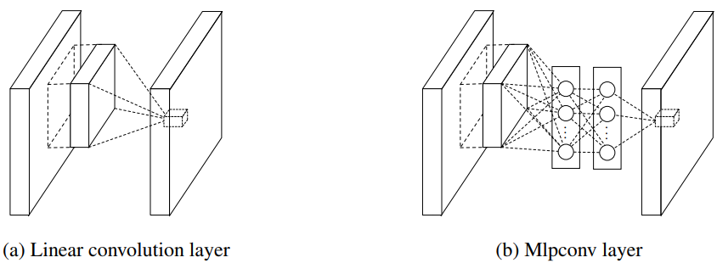
Network in Network (NiN)
Lin et al. Network in Network. ICLR 2014.

Slide 35
Network in Network (NiN)
Mlpconv layer with “micronetwork” within each conv layer to compute more abstract features for local patches
Micronetwork uses multilayer perceptron (FC, i.e. 1x1 conv layers)
Lin et al. Network in Network. ICLR 2014.
Source: cs231n

Slide 36
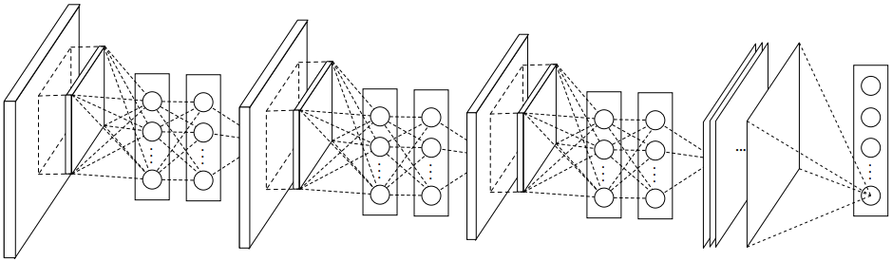
Network in Network (NiN)
The overall structure of NiN: stacking of three mlpconv layers and one global average pooling layer
Lin et al. Network in Network. 2014.

Slide 37
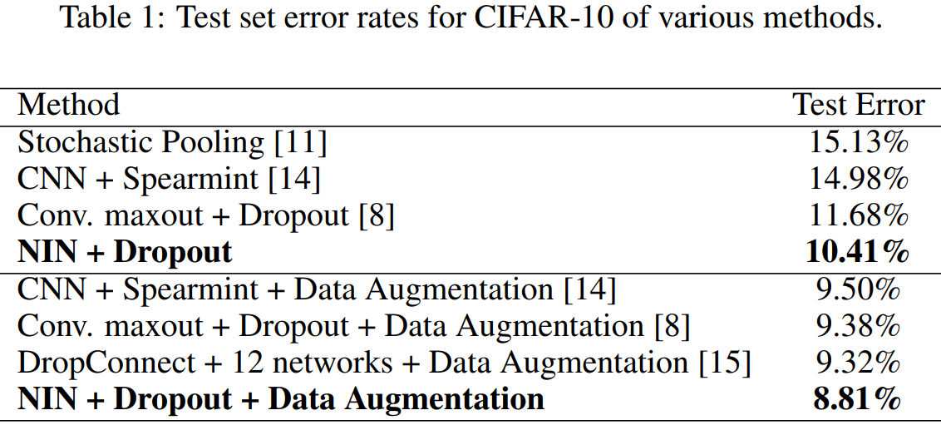
Network in Network (NiN)
The overall structure of NiN: stacking of three mlpconv layers and one global average pooling layer
Lin et al. Network in Network. 2014.

Slide 38
Network in Network (NiN)
The overall structure of NiN: stacking of three mlpconv layers and one global average pooling layer
Precursor to GoogLeNet and ResNet “bottleneck” layers
Philosophical inspiration for GoogLeNet
Lin et al. Network in Network. 2014.
Source: cs231n

Slide 39
CNN Architectures: DAG Models
GoogLeNet
ResNet
Pre-act ResNet
SENet
Network with Stochastic Depth
DenseNet
ResNetXt

Slide 40
ImageNet Large Scale Visual Recognition Challenge (ILSVRC) winners
Deeper Networks
K. He, X. Zhang, S. Ren, J. Sun, Deep Residual Learning for Image Recognition, IEEE CVPR 2016.

Slide 41
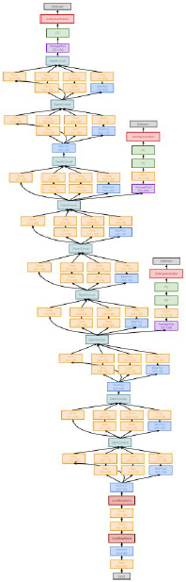
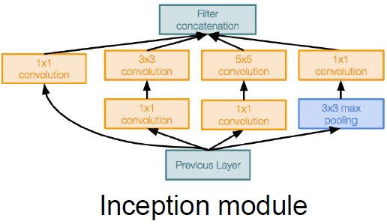
GoogLeNet
Deeper networks, with
computational efficiency
- 22 layers
- Efficient “Inception” module
- No FC layers
- Only 5 million parameters!
12x less than AlexNet
- Imagenet classification winner
(6.7% top 5 error)
Szegedy, Christian, et al. "Going deeper with convolutions." CVPR 2015.
Source: cs231n

Slide 42
GoogLeNet
“Inception module”:
design a good local network topology and then stack these modules on top of each other
Szegedy, Christian, et al. "Going deeper with convolutions." CVPR 2015.
Source: cs231n

Slide 43
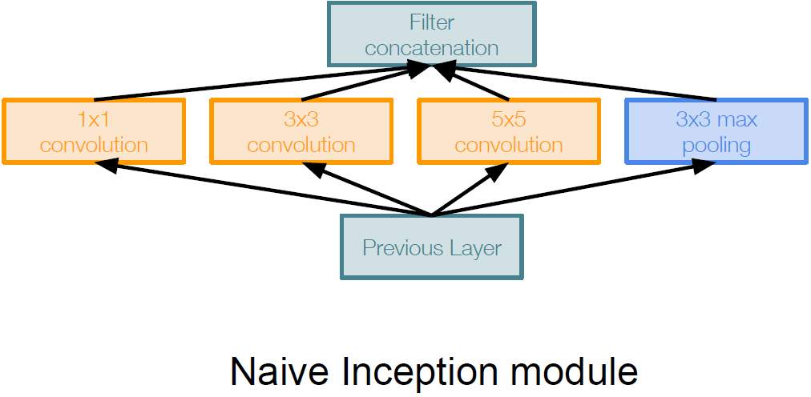
GoogLeNet
Apply parallel filter operations on the input from previous layer:
- Multiple receptive field sizes for convolution (1x1, 3x3, 5x5)
- Pooling operation (3x3)
Concatenate all filter outputs together depth-wise
Problem:
Computational Complexity
Szegedy, Christian, et al. "Going deeper with convolutions." CVPR 2015.
Source: cs231n

Slide 44
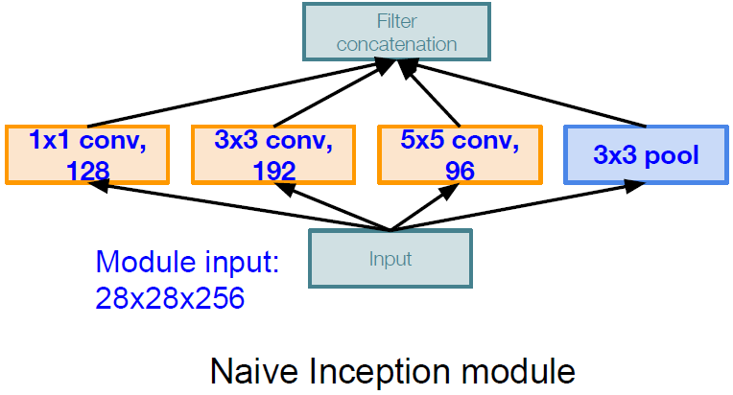
GoogLeNet
Problem:
Computational Complexity
Q1: What is the output size of the
1x1 conv, with 128 filters?
Example:
Szegedy, Christian, et al. "Going deeper with convolutions." CVPR 2015.
Source: cs231n

Slide 45
1×1 Convolutions
28
28
1x1 CONV
with 128 filters
(each filter has size
1x1x256, and performs a 256-dimensional dot
product)
28
28
32
256
128

Slide 46
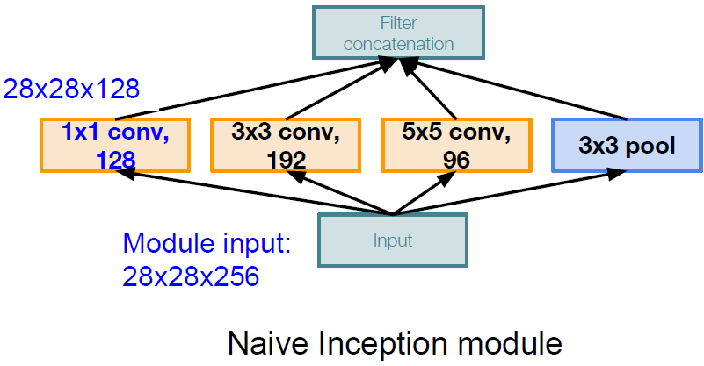
GoogLeNet
Problem:
Computational Complexity
Q1: What is the output size of the
1x1 conv, with 128 filters?
Example:
Szegedy, Christian, et al. "Going deeper with convolutions." CVPR 2015.
Source: cs231n

Slide 47
GoogLeNet
Problem:
Computational Complexity
Q2: What are the output sizes of
all different filter operations?
Example:
Szegedy, Christian, et al. "Going deeper with convolutions." CVPR 2015.
Source: cs231n

Slide 48
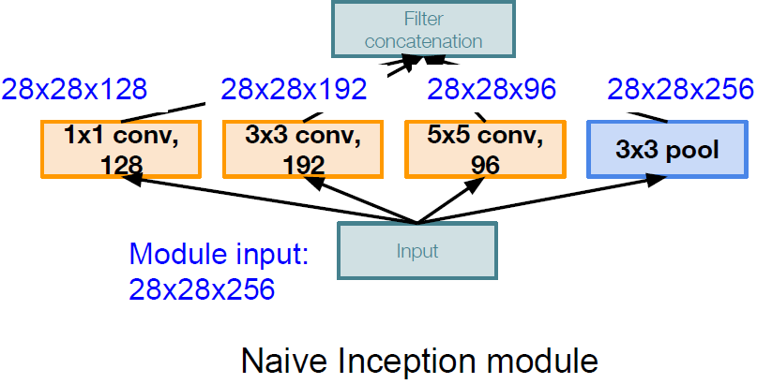
GoogLeNet
Problem:
Computational Complexity
Q2: What are the output sizes of
all different filter operations?
Example:
Szegedy, Christian, et al. "Going deeper with convolutions." CVPR 2015.
Source: cs231n

Slide 49
GoogLeNet
Problem:
Computational Complexity
Q3:What is output size after
filter concatenation?
Example:
Szegedy, Christian, et al. "Going deeper with convolutions." CVPR 2015.
Source: cs231n

Slide 50
GoogLeNet
Problem:
Computational Complexity
Q3:What is output size after
filter concatenation?
Example:
Szegedy, Christian, et al. "Going deeper with convolutions." CVPR 2015.
Source: cs231n

Slide 51
GoogLeNet
Problem:
Computational Complexity
Q3:What is output size after
filter concatenation?
Conv Ops:
[1x1 conv, 128]
28x28x128x1x1x256
[3x3 conv, 192]
28x28x192x3x3x256
[5x5 conv, 96]
28x28x96x5x5x256
Total: 854M ops
Very expensive compute
Example:
Szegedy, Christian, et al. "Going deeper with convolutions." CVPR 2015.
Source: cs231n

Slide 52
GoogLeNet
Problem:
Computational Complexity
Q3:What is output size after
filter concatenation?
Solution: “bottleneck” layers that use 1x1 convolutions to reduce
feature depth
Example:
Szegedy, Christian, et al. "Going deeper with convolutions." CVPR 2015.
Source: cs231n

Slide 53
1×1 Convolutions
28
28
1x1 CONV
with 128 filters
(each filter has size
1x1x256, and performs a 256-dimensional dot
product)
28
28
32
256
128
preserves spatial dimensions, reduces depth!
Projects depth to lower dimension (combination of feature maps)

Slide 54
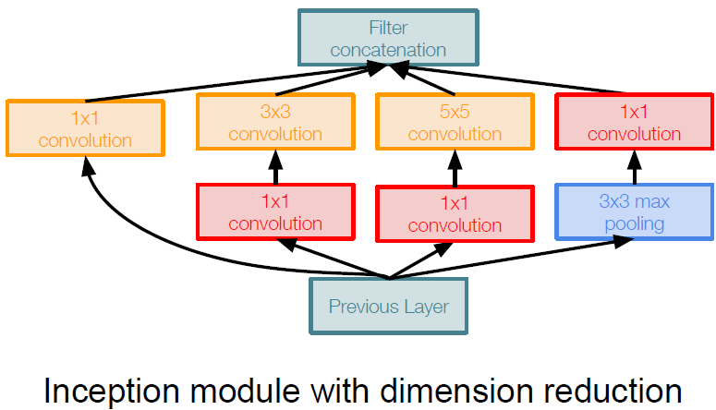
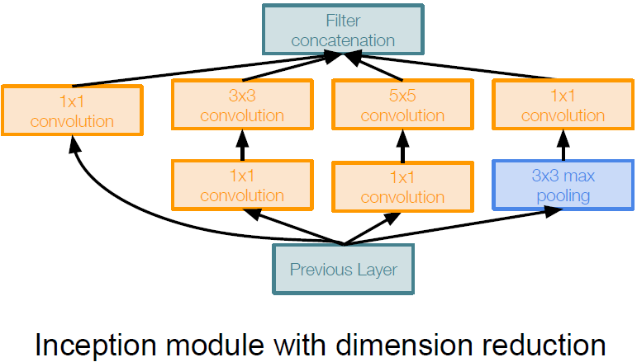
GoogLeNet
1x1 conv “bottleneck”
layers
Szegedy, Christian, et al. "Going deeper with convolutions." CVPR 2015.
Source: cs231n

Slide 55
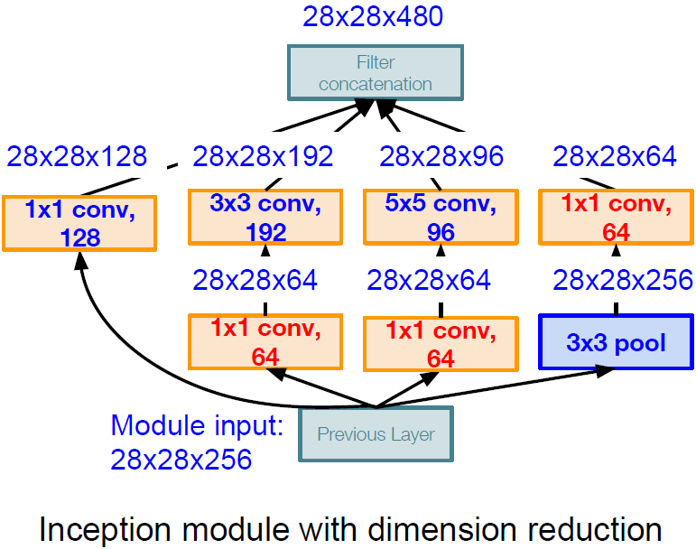
GoogLeNet
Conv Ops:
[1x1 conv, 64] 28x28x64x1x1x256
[1x1 conv, 64] 28x28x64x1x1x256
[1x1 conv, 128] 28x28x128x1x1x256
[3x3 conv, 192] 28x28x192x3x3x64
[5x5 conv, 96] 28x28x96x5x5x64
[1x1 conv, 64] 28x28x64x1x1x256
Total: 358M ops
Compared to 854M ops for naive version, Bottleneck can also reduce depth after pooling layer
Szegedy, Christian, et al. "Going deeper with convolutions." CVPR 2015.
Source: cs231n

Slide 56

GoogLeNet
Full GoogLeNet Architecture
Stem Network:
Conv-Pool-
2x Conv-Pool
Szegedy, Christian, et al. "Going deeper with convolutions." CVPR 2015.
Source: cs231n

Slide 57
GoogLeNet
Full GoogLeNet Architecture
Stacked Inception
Modules
Szegedy, Christian, et al. "Going deeper with convolutions." CVPR 2015.
Source: cs231n

Slide 58
GoogLeNet
Full GoogLeNet Architecture
Classifier output
(removed expensive FC layers!)
Szegedy, Christian, et al. "Going deeper with convolutions." CVPR 2015.
Source: cs231n

Slide 59
GoogLeNet
Full GoogLeNet Architecture
Auxiliary classification outputs to inject additional gradient at lower layers
(AvgPool-1x1Conv-FC-FC-Softmax)
Szegedy, Christian, et al. "Going deeper with convolutions." CVPR 2015.
Source: cs231n

Slide 60
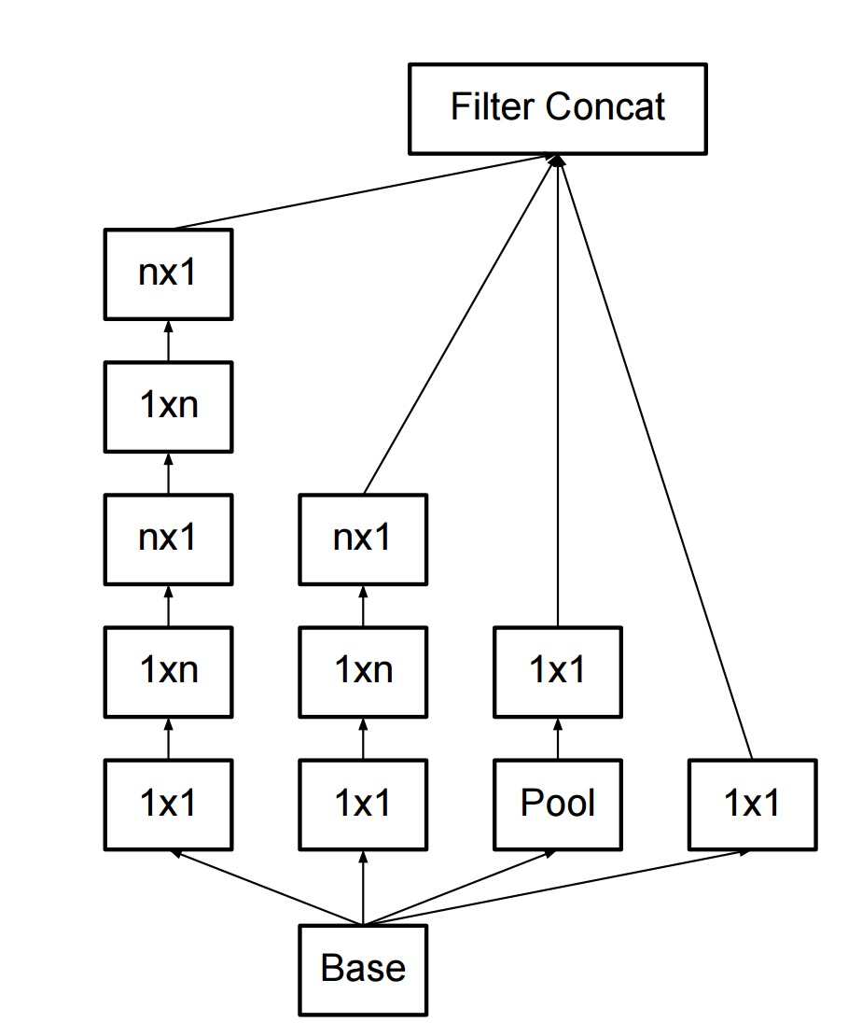
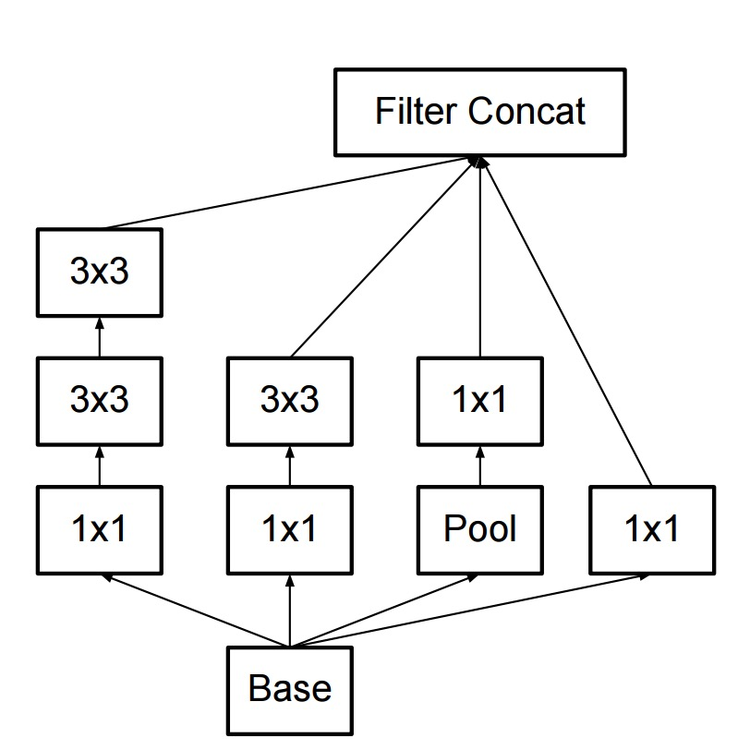
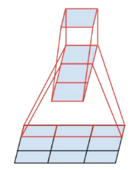
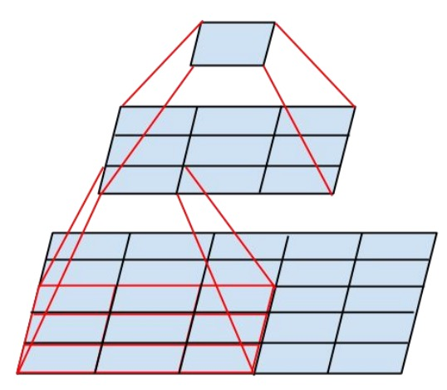
Inception v2, v3
Improve training with batch normalization, reducing importance of auxiliary classifiers
More variants of inception modules with aggressive factorization of filters
C. Szegedy et al., Rethinking the inception architecture for computer vision, CVPR 2016

Slide 61
ImageNet Large Scale Visual Recognition Challenge (ILSVRC) winners
Revolution of Depth
K. He, X. Zhang, S. Ren, J. Sun, Deep Residual Learning for Image Recognition, IEEE CVPR 2016.

Slide 62
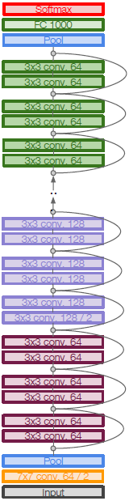
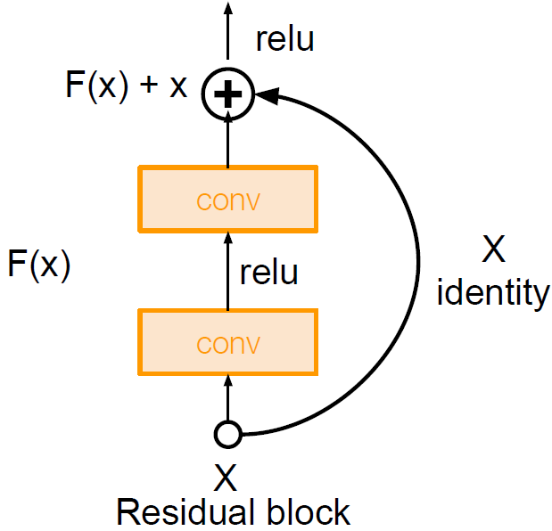
ResNet
Very deep networks using residual connections
- 152-layer model for ImageNet
- ILSVRC’15 classification winner
(3.57% top 5 error)
- Swept all classification and
detection competitions in
ILSVRC’15 and COCO’15!
He et al. Deep Residual Learning for Image Recognition, IEEE CVPR 2016.
Source: cs231n

Slide 63
ResNet
What happens when we continue stacking deeper layers on a “plain” convolutional neural network?
He et al. Deep Residual Learning for Image Recognition, IEEE CVPR 2016.
Source: cs231n

Slide 64
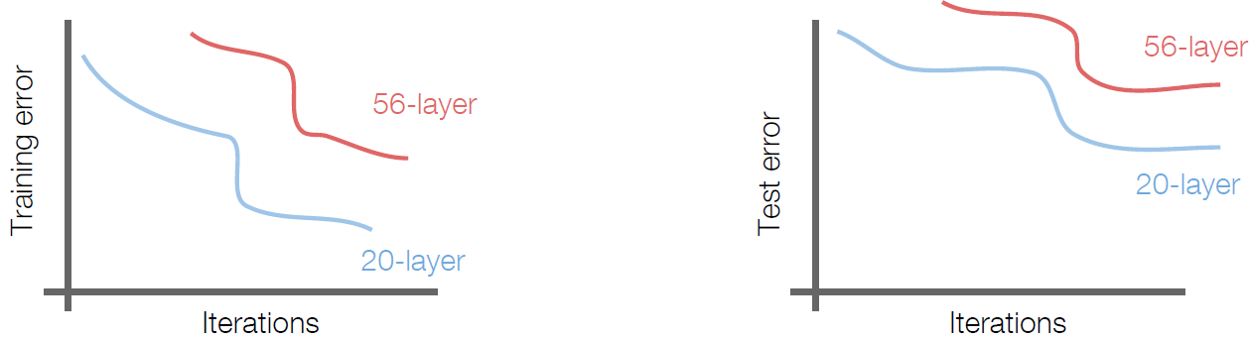
ResNet
What happens when we continue stacking deeper layers on a “plain” convolutional neural network?
56-layer model performs worse on both training and test error
-> The deeper model performs worse, but it’s not caused by overfitting!
He et al. Deep Residual Learning for Image Recognition, IEEE CVPR 2016.
Source: cs231n

Slide 65
ResNet
Hypothesis: the problem is an optimization problem, deeper models are harder to optimize
The deeper model should be able to perform at
least as well as the shallower model.
He et al. Deep Residual Learning for Image Recognition, IEEE CVPR 2016.
Source: cs231n

Slide 66
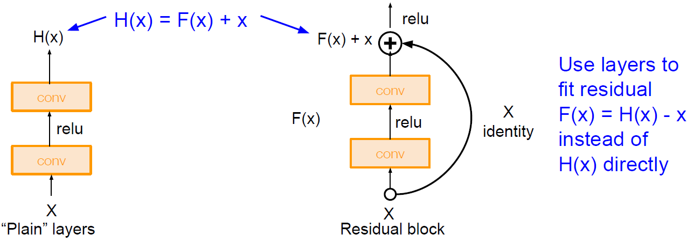
ResNet
Solution: Use network layers to fit a residual mapping instead of directly trying to fit a desired underlying mapping
He et al. Deep Residual Learning for Image Recognition, IEEE CVPR 2016.
Source: cs231n

Slide 67
ResNet
Solution: Use network layers to fit a residual mapping instead of directly trying to fit a desired underlying mapping
He et al. Deep Residual Learning for Image Recognition, IEEE CVPR 2016.
Source: cs231n

Slide 68
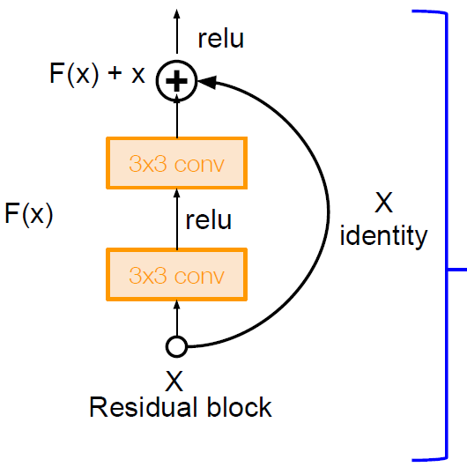
ResNet
Full ResNet architecture:
Stack residual blocks
Residual block has two 3x3 conv layers
He et al. Deep Residual Learning for Image Recognition, IEEE CVPR 2016.
Source: cs231n

Slide 69
ResNet
Full ResNet architecture:
Stack residual blocks
Residual block has two 3x3 conv layers
Periodically, double # of filters and downsample spatially using stride 2 (/2 in each dimension)
3x3 conv, 128 filters, /2 spatially with stride 2
3x3 conv, 64 filters
He et al. Deep Residual Learning for Image Recognition, IEEE CVPR 2016.
Source: cs231n

Slide 70
ResNet
Full ResNet architecture:
Stack residual blocks
Residual block has two 3x3 conv layers
Periodically, double # of filters and downsample spatially using stride 2 (/2 in each dimension)
Additional conv layer at the beginning
3x3 conv, 128 filters, /2 spatially with stride 2
3x3 conv, 64 filters
Beginning
conv layer
He et al. Deep Residual Learning for Image Recognition, IEEE CVPR 2016.
Source: cs231n

Slide 71
ResNet
No FC layers
besides FC
1000 to output
Classes
Global average
pooling layer
after last
conv layer
Full ResNet architecture:
Stack residual blocks
Residual block has two 3x3 conv layers
Periodically, double # of filters and downsample spatially using stride 2 (/2 in each dimension)
Additional conv layer at the beginning
No FC layers at the end (only FC 1000 to output classes)
3x3 conv, 128 filters, /2 spatially with stride 2
3x3 conv, 64 filters
Beginning
conv layer
He et al. Deep Residual Learning for Image Recognition, IEEE CVPR 2016.
Source: cs231n

Slide 72
ResNet
Total depths of 34, 50, 101, or 152 layers for ImageNet
He et al. Deep Residual Learning for Image Recognition, IEEE CVPR 2016.
Source: cs231n

Slide 73
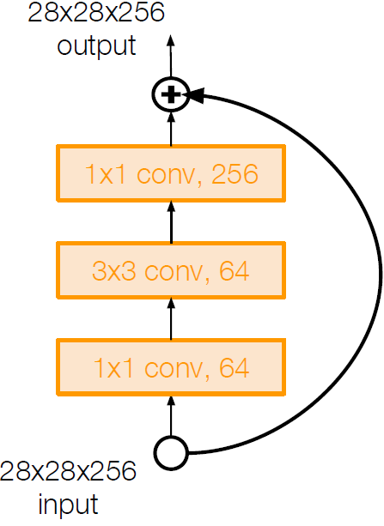
ResNet
For deeper networks (ResNet-50+):
use “bottleneck” layer to improve efficiency
(similar to GoogLeNet)
He et al. Deep Residual Learning for Image Recognition, IEEE CVPR 2016.
Source: cs231n

Slide 74
ResNet
Training ResNet in practice:
Batch Normalization after every CONV layer
Xavier/2 initialization from He et al.
SGD + Momentum (0.9)
Learning rate: 0.1, divided by 10 when validation error saturates
Mini-batch size 256
Weight decay of 1e-5 for penalizing regularization term
No dropout used
He et al. Deep Residual Learning for Image Recognition, IEEE CVPR 2016.
Source: cs231n

Slide 75
ResNet
Experimental Results:
Able to train very deep networks without degrading (152 layers on ImageNet, 1202 on Cifar)
Deeper networks now achieve lower training error as expected
Swept 1st place in all ILSVRC and COCO 2015 competitions
He et al. Deep Residual Learning for Image Recognition, IEEE CVPR 2016.
Source: cs231n

Slide 76
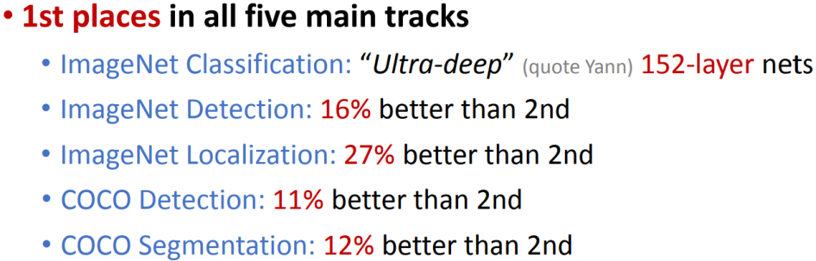
ResNet
Experimental Results:
Able to train very deep networks without degrading (152 layers on ImageNet, 1202 on Cifar)
Deeper networks now achieve lower training error as expected
Swept 1st place in all ILSVRC and COCO 2015 competitions
He et al. Deep Residual Learning for Image Recognition, IEEE CVPR 2016.
Source: cs231n

Slide 77
ResNet
Experimental Results:
Able to train very deep networks without degrading (152 layers on ImageNet, 1202 on Cifar)
Deeper networks now achieve lower training error as expected
Swept 1st place in all ILSVRC and COCO 2015 competitions
ILSVRC 2015 classification winner (3.6% top 5 error) -- better than “human performance”! (Russakovsky 2014)
He et al. Deep Residual Learning for Image Recognition, IEEE CVPR 2016.
Source: cs231n

Slide 78
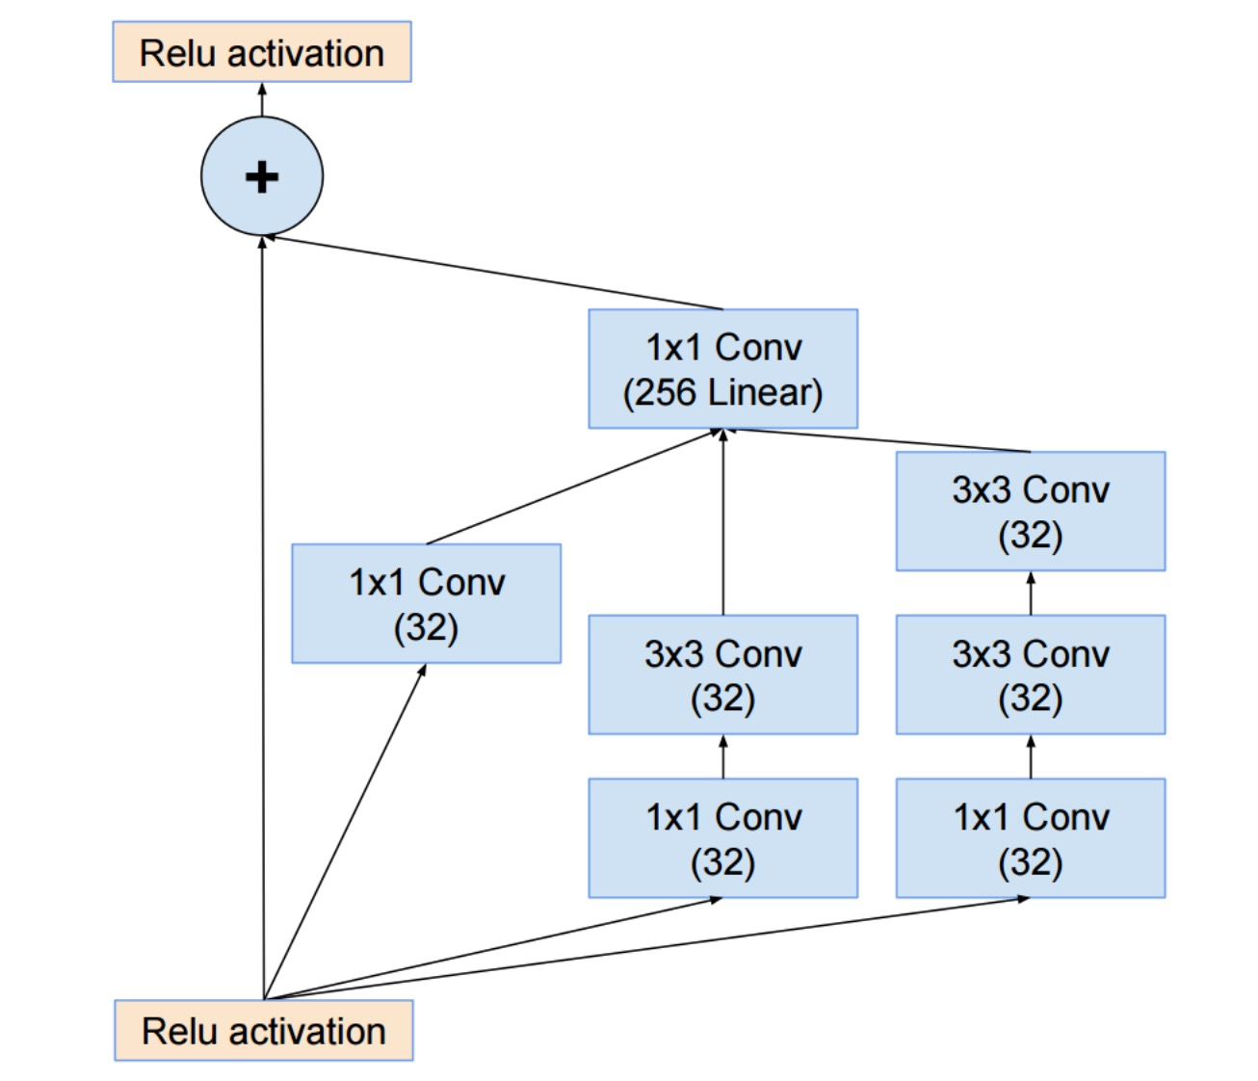
Inception v4
Inception-v4: Resnet + Inception!
C. Szegedy et al., Inception-v4, Inception-ResNet and the Impact of Residual Connections on Learning, arXiv 2016

Slide 79
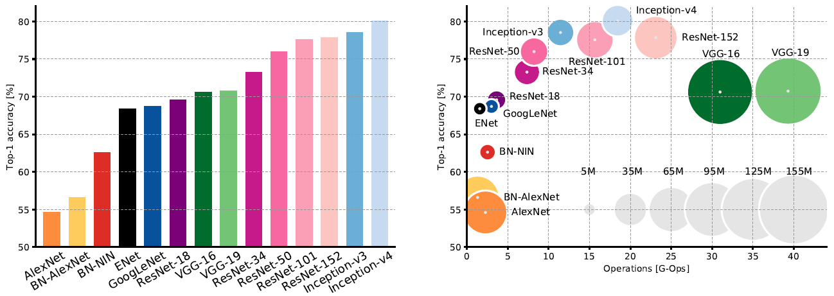
Comparing Complexity …
Canziani et al. An Analysis of Deep Neural Network Models for Practical Applications, 2017.
Source: cs231n

Slide 80
Comparing Complexity …
VGG: Highest
memory, most
operations
Canziani et al. An Analysis of Deep Neural Network Models for Practical Applications, 2017.
Source: cs231n

Slide 81
Comparing Complexity …
GoogLeNet:
most efficient
Canziani et al. An Analysis of Deep Neural Network Models for Practical Applications, 2017.
Source: cs231n

Slide 82
Comparing Complexity …
AlexNet:
Smaller compute, still memory
heavy, lower accuracy
Canziani et al. An Analysis of Deep Neural Network Models for Practical Applications, 2017.
Source: cs231n

Slide 83
Comparing Complexity …
ResNet:
Moderate efficiency depending
on model, highest accuracy
Canziani et al. An Analysis of Deep Neural Network Models for Practical Applications, 2017.
Source: cs231n

Slide 84
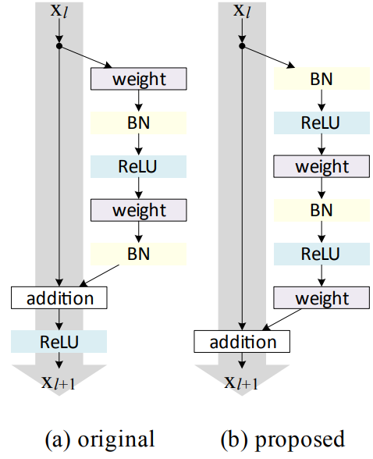
Pre-activated ResNet
He, Kaiming, et al. "Identity mappings in deep residual networks." Europ. conf. on computer vision (ECCV), 2016.

Slide 85
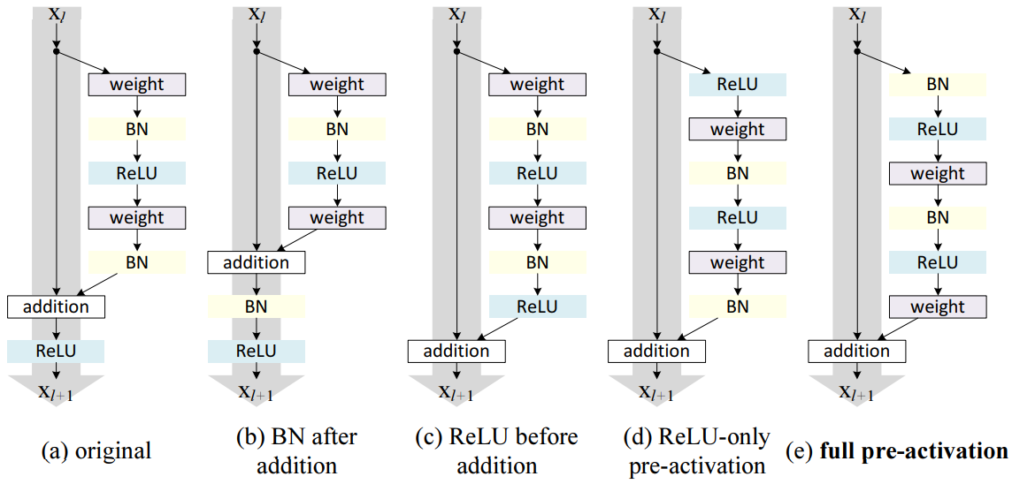
Pre-activated ResNet
He, Kaiming, et al. "Identity mappings in deep residual networks." Europ. conf. on computer vision (ECCV), 2016.

Slide 86
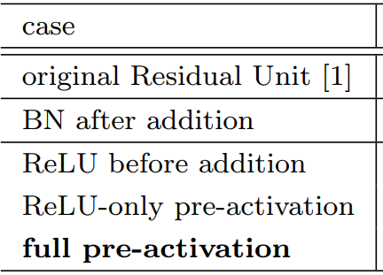
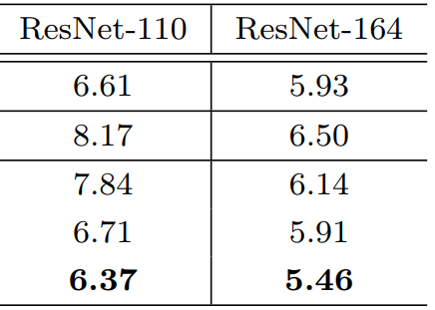
Pre-activated ResNet
Classification error (%) on the CIFAR-10 test set using different activation functions.
He, Kaiming, et al. "Identity mappings in deep residual networks." Europ. conf. on computer vision (ECCV), 2016.

Slide 87
SENet (Squeeze and Excitation Network)
2017 ImageNet Challenge Winner
Top-5 Error: 2.251%
Hu et al. Squeeze-and-Excitation Networks, CVPR 2018.

Slide 88
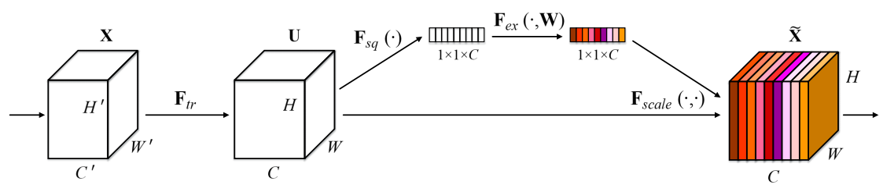
SENet (Squeeze and Excitation Network)
2017 ImageNet Challenge Winner
Top-5 Error: 2.251%
“Squeeze-and-Excitation”(SE) block adaptively recalibrates
channel-wise feature responses
by explicitly modelling interdependencies between channels.
Hu et al. Squeeze-and-Excitation Networks, CVPR 2018.

Slide 89

SENet (Squeeze and Excitation Network)
2017 ImageNet Challenge Winner
Top-5 Error: 2.251%
Squeeze: Average Global Pooling
c^{th} channel of C
Hu et al. Squeeze-and-Excitation Networks, CVPR 2018.

Slide 90

SENet (Squeeze and Excitation Network)
2017 ImageNet Challenge Winner
Top-5 Error: 2.251%
Excitation:
Adaptive Recalibration
Hu et al. Squeeze-and-Excitation Networks, CVPR 2018.

Slide 91
SENet (Squeeze and Excitation Network)
2017 ImageNet Challenge Winner
Top-5 Error: 2.251%
Excitation:
Adaptive Recalibration
Hu et al. Squeeze-and-Excitation Networks, CVPR 2018.

Slide 92
SENet (Squeeze and Excitation Network)
2017 ImageNet Challenge Winner
Top-5 Error: 2.251%
Excitation:
Adaptive Recalibration
r = 16 in experiment
Hu et al. Squeeze-and-Excitation Networks, CVPR 2018.

Slide 93



SENet (Squeeze and Excitation Network)
2017 ImageNet Challenge Winner
Top-5 Error: 2.251%
Excitation:
Adaptive Recalibration
r = 16 in experiment
Hu et al. Squeeze-and-Excitation Networks, CVPR 2018.

Slide 94
SENet (Squeeze and Excitation Network)
2017 ImageNet Challenge Winner
Top-5 Error: 2.251%
Excitation:
Adaptive Recalibration
r = 16 in experiment
Hu et al. Squeeze-and-Excitation Networks, CVPR 2018.

Slide 95

SENet (Squeeze and Excitation Network)
2017 ImageNet Challenge Winner
Top-5 Error: 2.251%
Scaling:
Hu et al. Squeeze-and-Excitation Networks, CVPR 2018.

Slide 96

SE-Inception Module
Hu et al. Squeeze-and-Excitation Networks, CVPR 2018.

Slide 97

SE-ResNet Module
Hu et al. Squeeze-and-Excitation Networks, CVPR 2018.

Slide 98
Other ResNet Improvements to Know …

Slide 99

Deep Networks with Stochastic Depth
Motivation: reduce vanishing gradients and training time through short networks during training
Randomly drop a subset of layers during each training pass
Bypass with identity function
Use full deep network at test time
Huang et al. Deep networks with stochastic depth. ECCV 2016.
Source: cs231n

Slide 100

Wide ResNet
Reduce number of residual blocks, but increase number of feature maps in each block
More parallelizable, better feature reuse
16-layer WRN outperforms 1000-layer ResNets, though with much larger # of parameters
Image source
S. Zagoryuko and N. Komodakis, Wide Residual Networks, BMVC 2016

Slide 101



DenseNet
Shorter connections (like ResNet) help
Why not just connect them all?
Huang et al. Densely connected convolutional networks. CVPR 2017.

Slide 102

Aggregated Residual Transformations for Deep Neural Networks (ResNeXt)
Improved ResNet
Increases width of residual block through multiple parallel pathways (“cardinality”)
Parallel pathways similar in spirit to Inception module
Xie et al. Aggregated residual transformations for deep neural networks. CVPR 2017.
Source: cs231n

Slide 103
Design principles
Make networks parameter-efficient
Reduce filter sizes, factorize filters
Use 1x1 convolutions to reduce number of feature maps before more expensive operations
Minimize reliance on FC layers
Reduce spatial resolution gradually, within each level of resolution replicate a given “block” multiple times
Use skip connections and/or create multiple redundant paths through the network
Play around with depth vs. width vs. “cardinality”

Slide 104
Acknowledgement
Deep Learning, Stanford University
Introduction to Deep Learning, University of Illinois at Urbana-Champaign
Introduction to Deep Learning, Carnegie Mellon University
Convolutional Neural Networks for Visual Recognition, Stanford University
Natural Language Processing with Deep Learning, Stanford University
NVDIEA Deep Learning Teaching Kit
And Many More …

